Slide 1
Infrastructure as a Code
Azure Training

Slide 2
Agenda
Intro to infrastructure as a code (IaaC)
ARM Introduction
Terraform Introduction
Injecting Parameters
Secure Infrastructure deployment
Questions

Slide 3

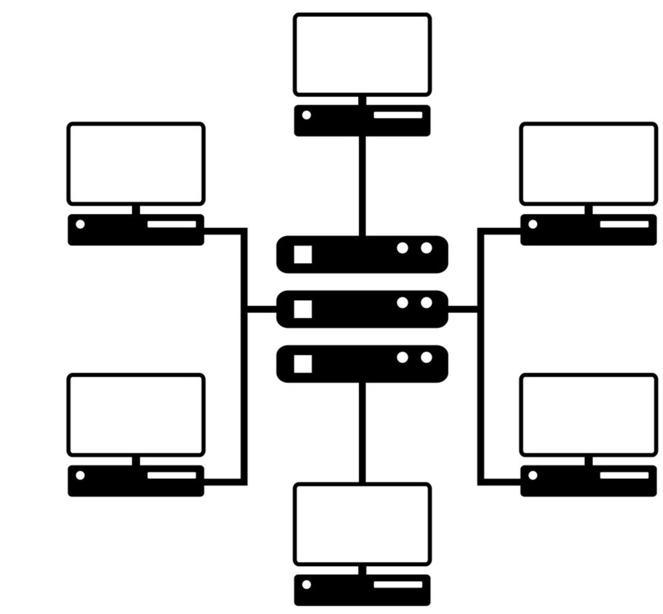
Intro to Infrastructure as a code
Problem:
Deploying Software Infrastructure takes time that should be used for development that brings value to end users
Same infrastructure need to be deployed for multiple environments and all environment should be identical (with exceptions)
Documentation is required for complex deployments e.g. release notes that specify the order, permissions etc. to make solutions aligned across different environments
In case of change updates to the infrastructure need to be done on multiple environments
Upload ARM Templates to Repo
Define Build Pipeline
Create Release Pipeline
Assign variables to pipeline
Self-contained: Access = copy of Repo and entire codebase and history

Slide 4
Solution:
Infrastructure as a code
Can be implemented with ARM Templates/Terraform/Bicep/Powershell/CLI/CMD/BASH
Visualising a DTP | 3

Slide 5
Intro to Infrastructure as a code – What is IAC?
What is Infrastructure as a code?
IaaC – Infrastructure as a Code
Defining a solution infrastructure in form of the code (stored in code files)
Infrastructure
Definition
Deployed Infrastructure
Notes:
Infrastructure as a Code
Are there any other types of templates:
Yes – e.g. Terraform (They use different syntax), they would also require different deployment script

Slide 6




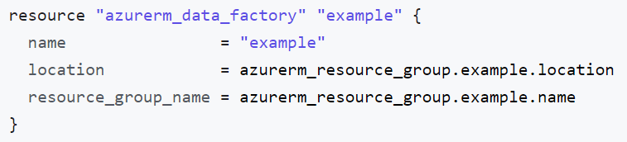

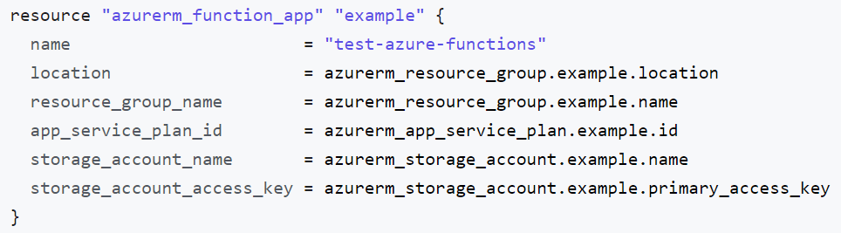
Intro to Infrastructure as a code – What is IAC?
Infrastructure Code File
Deployed Environments
DEV-RG
Data Factory (ADF)
ADF-DEV
AF-DEV
Dev Param
Test Param
Function Apps (AF)
TEST-RG
ADF-TEST
AF-TEST
Notes:
Infrastructure as a Code
Are there any other types of templates:
Yes – e.g. Terraform (They use different syntax), they would also require different deployment script

Slide 7



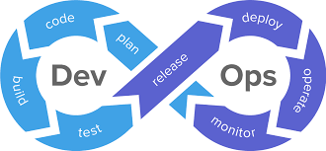

Intro to Infrastructure as a code – What is IAC?
Why do we need IaaC?
Quick
Source Control Enabled
Reusable
Enables DevOps and CICD
Repeatable (Idempotent)

Slide 8





Intro to Infrastructure as a code – What is IAC?
Most popular IaaC Providers?
MS
ARM Templates
MS
Azure Bicep
Notes:
Infrastructure as a Code
Are there any other types of templates:
Yes – e.g. Terraform (They use different syntax), they would also require different deployment script

Slide 9
Intro to Infrastructure as a code – What is IAC?
Dependencies
BICEP (DSL)
PULUMI (Python, c#, js)
ARM (JSON)
TERRAFORM (DSL)
API call
API call
API call
Cloud Provider APIs
Notes:
Infrastructure as a Code
Are there any other types of templates:
Yes – e.g. Terraform (They use different syntax), they would also require different deployment script

Slide 10



Intro to Infrastructure as a code – ARM vs Terraform
V S
ARM Templates
Azure Specific (no other providers)
Cloud Provider Agnostic (other providers)
Maintain State in Azure (Easier)
Maintain State Externally (Additional Hussle)
JSON + easy expression language
Written in HashiCorp config language
No Workflow (Commands)
Workflow “Destroy” function
Not very concise (lengthy, unreadable)
Concise (easier to read)
No AAD operations
AAD operations
Native (no lag in implementation)
Not Native (lag in implementation)
Not very modularised (poor reusability)
Easy to modularise
Notes:
Source Control – tracking and managing changes to the code (GIT can track binary files but it is not recommended in great extent)
Version Control – similar but also for binary files
GIT and TFVC (Can be used in dev ops)

Slide 11
Agenda
Intro to infrastructure as a code (IaaC)
ARM Introduction
Terraform Introduction
Injecting Parameters
Secure Infrastructure deployment
Questions

Slide 12

Intro to Infrastructure as a code – Introduction to ARM
ARM Templates
Notes:
Infrastructure as a Code
Are there any other types of templates:
Yes – e.g. Terraform (They use different syntax), they would also require different deployment script

Slide 13

Intro to Infrastructure as a code – What is ARM and ARM Templates
What is ARM?
Azure
Resource
Manager
What is ARM Template?
It is JSON file that describes services according to ARM Specification that will be created by Azure Resource Manager API
Notes:
Infrastructure as a Code
Are there any other types of templates:
Yes – e.g. Terraform (They use different syntax), they would also require different deployment script

Slide 14

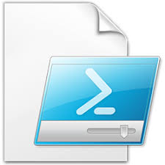
Intro to Infrastructure as a code – Understanding ARM Templates
Is ARM Template alone?
ARM Template
File naming convention: azuredeploy.template.json
Defines what we want to deploy and controls the way parameters are assigned to each resources
Parameter file
File naming convention: azuredeploy.parameters.json
Defines the parameters that will be passed into ARM Template
Power-Shell Deployment Scripts + additional configuration
executes PS1 command-lets that make deployment of ARM Template using ARM API
Notes:
#Template
Usually we will have single template that defines resources that we want to deploy. It is up to us to decide if we want to deploy all the resources with one template or to do one service per template
#Parameter File
It can store configuration values – configuration as a code
You can create multiple files with different parameters (usually one per environment)
Deployment could be done this way but later on we will learn how to do it without this file.

Slide 15

Intro to Infrastructure as a code – Understanding ARM Templates
Azure Resource Deployment Flow
ARM Template
(Resource 1, Resource 2,
Resource N)
Resource Group
+
=>
ARM Parameter File
e.g.
Dev
UAT
Prod
Deployment script
(Resource 1, Resource 2, Resource N)
Notes:
#With the standard deployment PowerShell script that is publicly available:
Single execution will deploy all resources specified
There are different mode available:
Incremental (default) – update the resources, do not trash all resources in resource group
Complete – trash what exist in resource group, use with care as that may delete all you resources like databases, storage accounts etc.

Slide 16
Intro to Infrastructure as a code – Understanding ARM Templates
What is ARM Template?
{
"$schema": "https://schema.management.azure.com/schemas/2015-01-01/deploymentTemplate.json#",
"contentVersion": "",
"apiProfile": "",
"parameters": { },
"variables": { },
"functions": [ ],
"resources": [ ],
"outputs": { }
}
Notes:
#ARM Template is JSON
Schema– must be defined for ARM API to understand what deployment type ARM Template requires (Subscription, Resource Group- recommended)
ConenteVersion - Version of the template that would allow you to track changes
ApiProfile - An API version that serves as a collection of API versions for resource types
Parameters – defines parameters, their: types, default values, metadata description
Variables – User-defined variables that can be reused within the template. E.g. when we want to combine two parameters
Functions – User-defined functions that are available within the template.
Resources – this section contain definition
Outputs – Defines values that need to be outputted
#Characteristic of ARM
Is composed of different sections, when each section has its own responsibility (explained below)
Definition of each resource is strictly defined (templates can be found online or in VisualStudio ARM Project)
Can contain expression define by ARM language to dynamically control some of the content e.g. variables etc.
Can be automated by Power-Shell ( we can inject parameters)
Can contain multiple resources might be linked to each other (resources section is an array), it determines dependencies and deploy resources in right order
#References:
Detailed explanations can be found here:
https://docs.microsoft.com/en-us/azure/azure-resource-manager/resource-group-authoring-templates

Slide 17
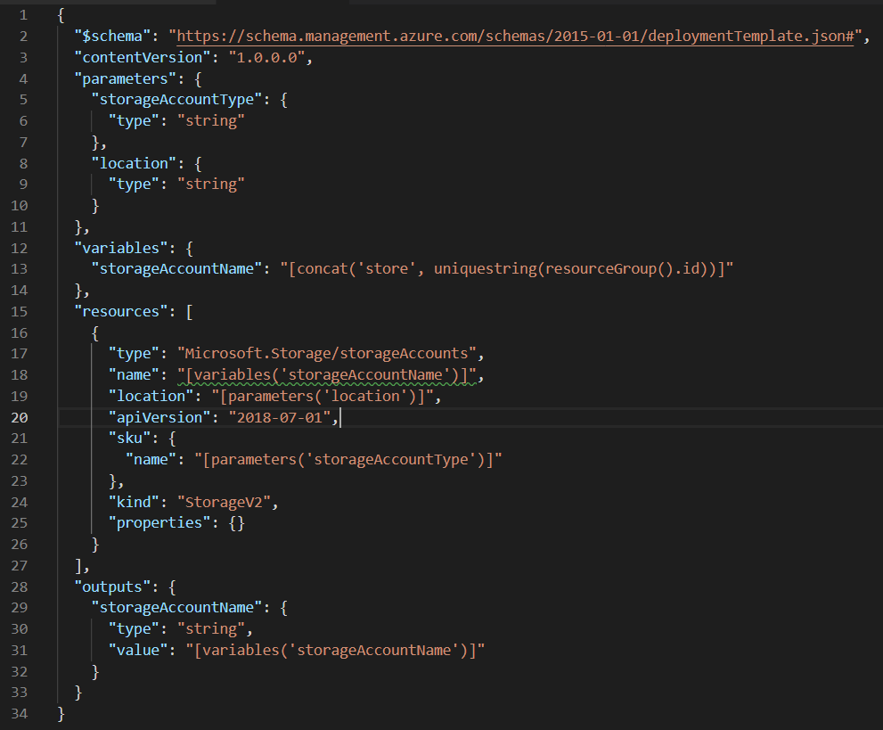
Intro to Infrastructure as a code – Understanding ARM Templates
Real World ARM Template Example – Blob
Input parameters
Variables
Resources
Outputs
Notes:
#ARM Template is JSON
Schema, ConenteVersion, ApiProfile – must be defined for ARM API to understand what version of the schema your ARM Template requires
Parameters – defines parameters, their: types, default values, metadata description
Variables – defines variables that can be reused. E.g. when we want to combine two parameters
Functions – allow to define transformations that can be used to dynamically modify data
Resources – this section contain definition
Outoputs – Defines values that need to be outputted
#Characteristic of ARM
Is composed of different sections, when each section has its own responsibility (explained below)
Definition of each resource is strictly defined (templates can be found online or in VisualStudio ARM Project)
Can contain expression define by ARM language to dynamically control some of the content e.g. variables etc.
Can be automated by Power-Shell ( we can inject parameters)
Can contain multiple resources might be linked to each other (resources section is an array), it determines dependencies and deploy resources in right order

Slide 18
Intro to Infrastructure as a code – Expression Language
Expressions
Used in variables, functions, can
All expressions are wrapped in square brackets “[ ]”
Syntax is specified in MS Documentation (allowed functions)
The value of the expression is evaluated when the template is deployed
An expression must on of the defined types: string, integer, boolean, array, or object
A template expression can't exceed 24,576 characters.
Examples of Expressions
[resourceGroup().location]
[parameters(‘parameter_name’)]
[variables(‘variable_name’)]
Notes:
Dynamic content can be added to ARM template via Expression language
# list of all available expressions functions can be found here:
https://docs.microsoft.com/en-us/azure/azure-resource-manager/resource-group-template-functions
Language expressions are evaluated at deployment time (runtime)

Slide 19
Agenda
Intro to infrastructure as a code (IaaC)
ARM Introduction
Terraform Introduction
Injecting Parameters
Secure Infrastructure deployment
Questions

Slide 20
Intro to Infrastructure as a code – Introduction to Terraform
Notes:
Infrastructure as a Code
Are there any other types of templates:
Yes – e.g. Terraform (They use different syntax), they would also require different deployment script

Slide 21
Intro to Infrastructure as a code – Introduction to Terraform
What is Terraform?
IaaC implementation from HashiCorp
Code Files written in the HashiCorp Language (Text file based)
Open Source
External State
Workflow based
Notes:
Infrastructure as a Code
Are there any other types of templates:
Yes – e.g. Terraform (They use different syntax), they would also require different deployment script

Slide 22
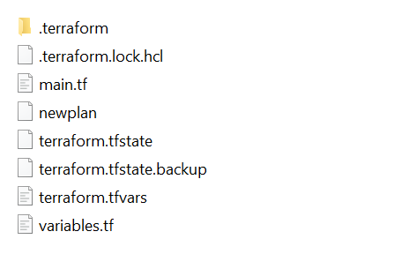
Intro to Infrastructure as a code – Introduction to Terraform
Terraform Workspace
Main terraform definition
Contains named plan
Contains Current State
Plan Backup
Variable File
Variable's definition file
Notes:
Infrastructure as a Code
Are there any other types of templates:
Yes – e.g. Terraform (They use different syntax), they would also require different deployment script

Slide 23


Intro to Infrastructure as a code – Introduction to Terraform
Terraform Lifecycle – Create/Update/Destroy
Is Plan Correct
Stop
Configure Terraform
INIT
Create/Update Templates
PLAN
YES
APPLY
Start
Create/Update Infrastructure
NO
CLOUD PROVIDER
Destroy infrastructure
Start
Is Plan Correct
Stop
DESTROY
YES
NO
Notes:
To run the commands, it is required to have installed and configured Terraform CLI and Azure Az/Azure RM modules, also Azure CLI

Slide 24
Intro to Infrastructure as a code – Introduction to Terraform
Terraform Commands Summary
-Terraform INIT – command run on the directory where main terraform file is created to initialize configuration and download all required dependencies
-Terraform PLAN [Plan_Name] – Creates a plan that shows all the steps that will be executed in the apply phase to align target solution to its desired state
-Terraform APPLY [Plan_Name]
-Terraform DESTROY – removes all the objects defined in the current configuration
Notes:
To run the commands, it is required to have installed and configured Terraform CLI and Azure Az/Azure RM modules, also Azure CLI

Slide 25
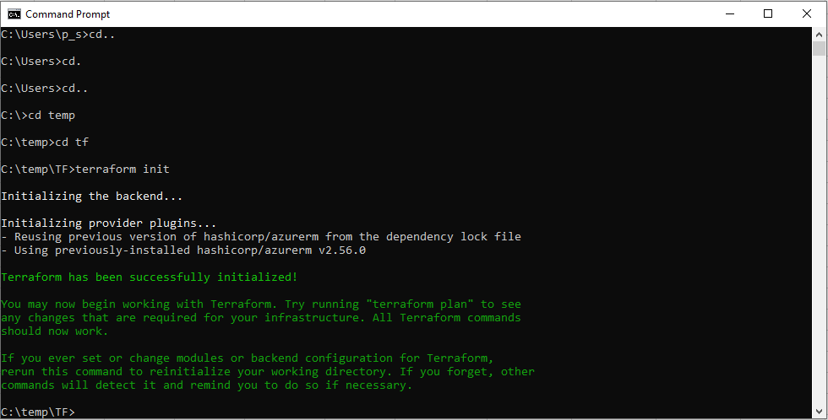
Module 2 – Introduction to Terraform - Parameters
Terraform CLI
Open CMD
Navigate to Local workspace where terraform will be created
Invoke Init command “terraform init” in cmd
Create your resources in main.tf
run command: “terraform plan”
Review Plan
run command: “terraform apply”
Notes:
Infrastructure as a Code
Are there any other types of templates:
Yes – e.g. Terraform (They use different syntax), they would also require different deployment script

Slide 26
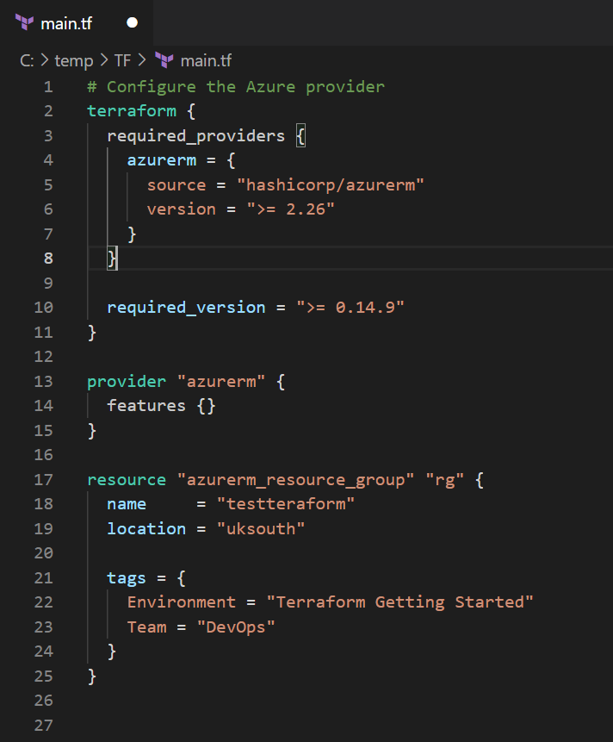
Intro to Infrastructure as a code – Introduction to Terraform
Defining Template
Provider Dependencies
Provider Definition
Resources
Notes:
Infrastructure as a Code
Are there any other types of templates:
Yes – e.g. Terraform (They use different syntax), they would also require different deployment script

Slide 27
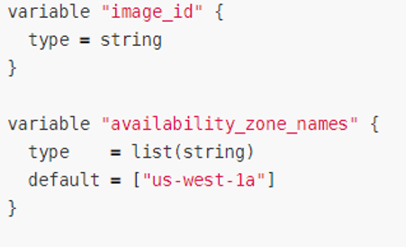
Intro to Infrastructure as a code – Introduction to Terraform
Defining Parameters/Variables
Defining Parameters in the terraform template
Notes:
Infrastructure as a Code
Are there any other types of templates:
Yes – e.g. Terraform (They use different syntax), they would also require different deployment script

Slide 28
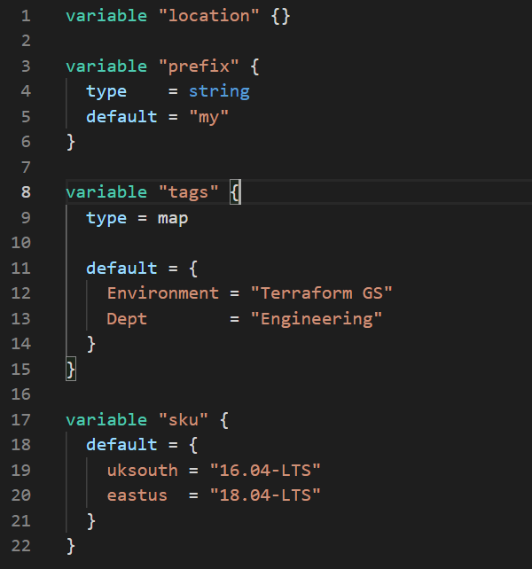
Intro to Infrastructure as a code – Introduction to Terraform
Defining Parameters/Variables
Defining Parameters in the external file
Notes:
Infrastructure as a Code
Are there any other types of templates:
Yes – e.g. Terraform (They use different syntax), they would also require different deployment script

Slide 29
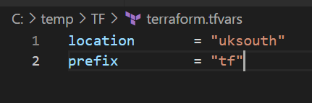
Intro to Infrastructure as a code – Introduction to Terraform
Providing Parameters/Variables
Injecting from the Pipeline
Providing Parameters in the external file
Notes:
Infrastructure as a Code
Are there any other types of templates:
Yes – e.g. Terraform (They use different syntax), they would also require different deployment script

Slide 30
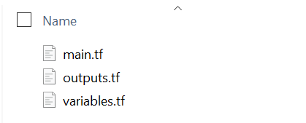
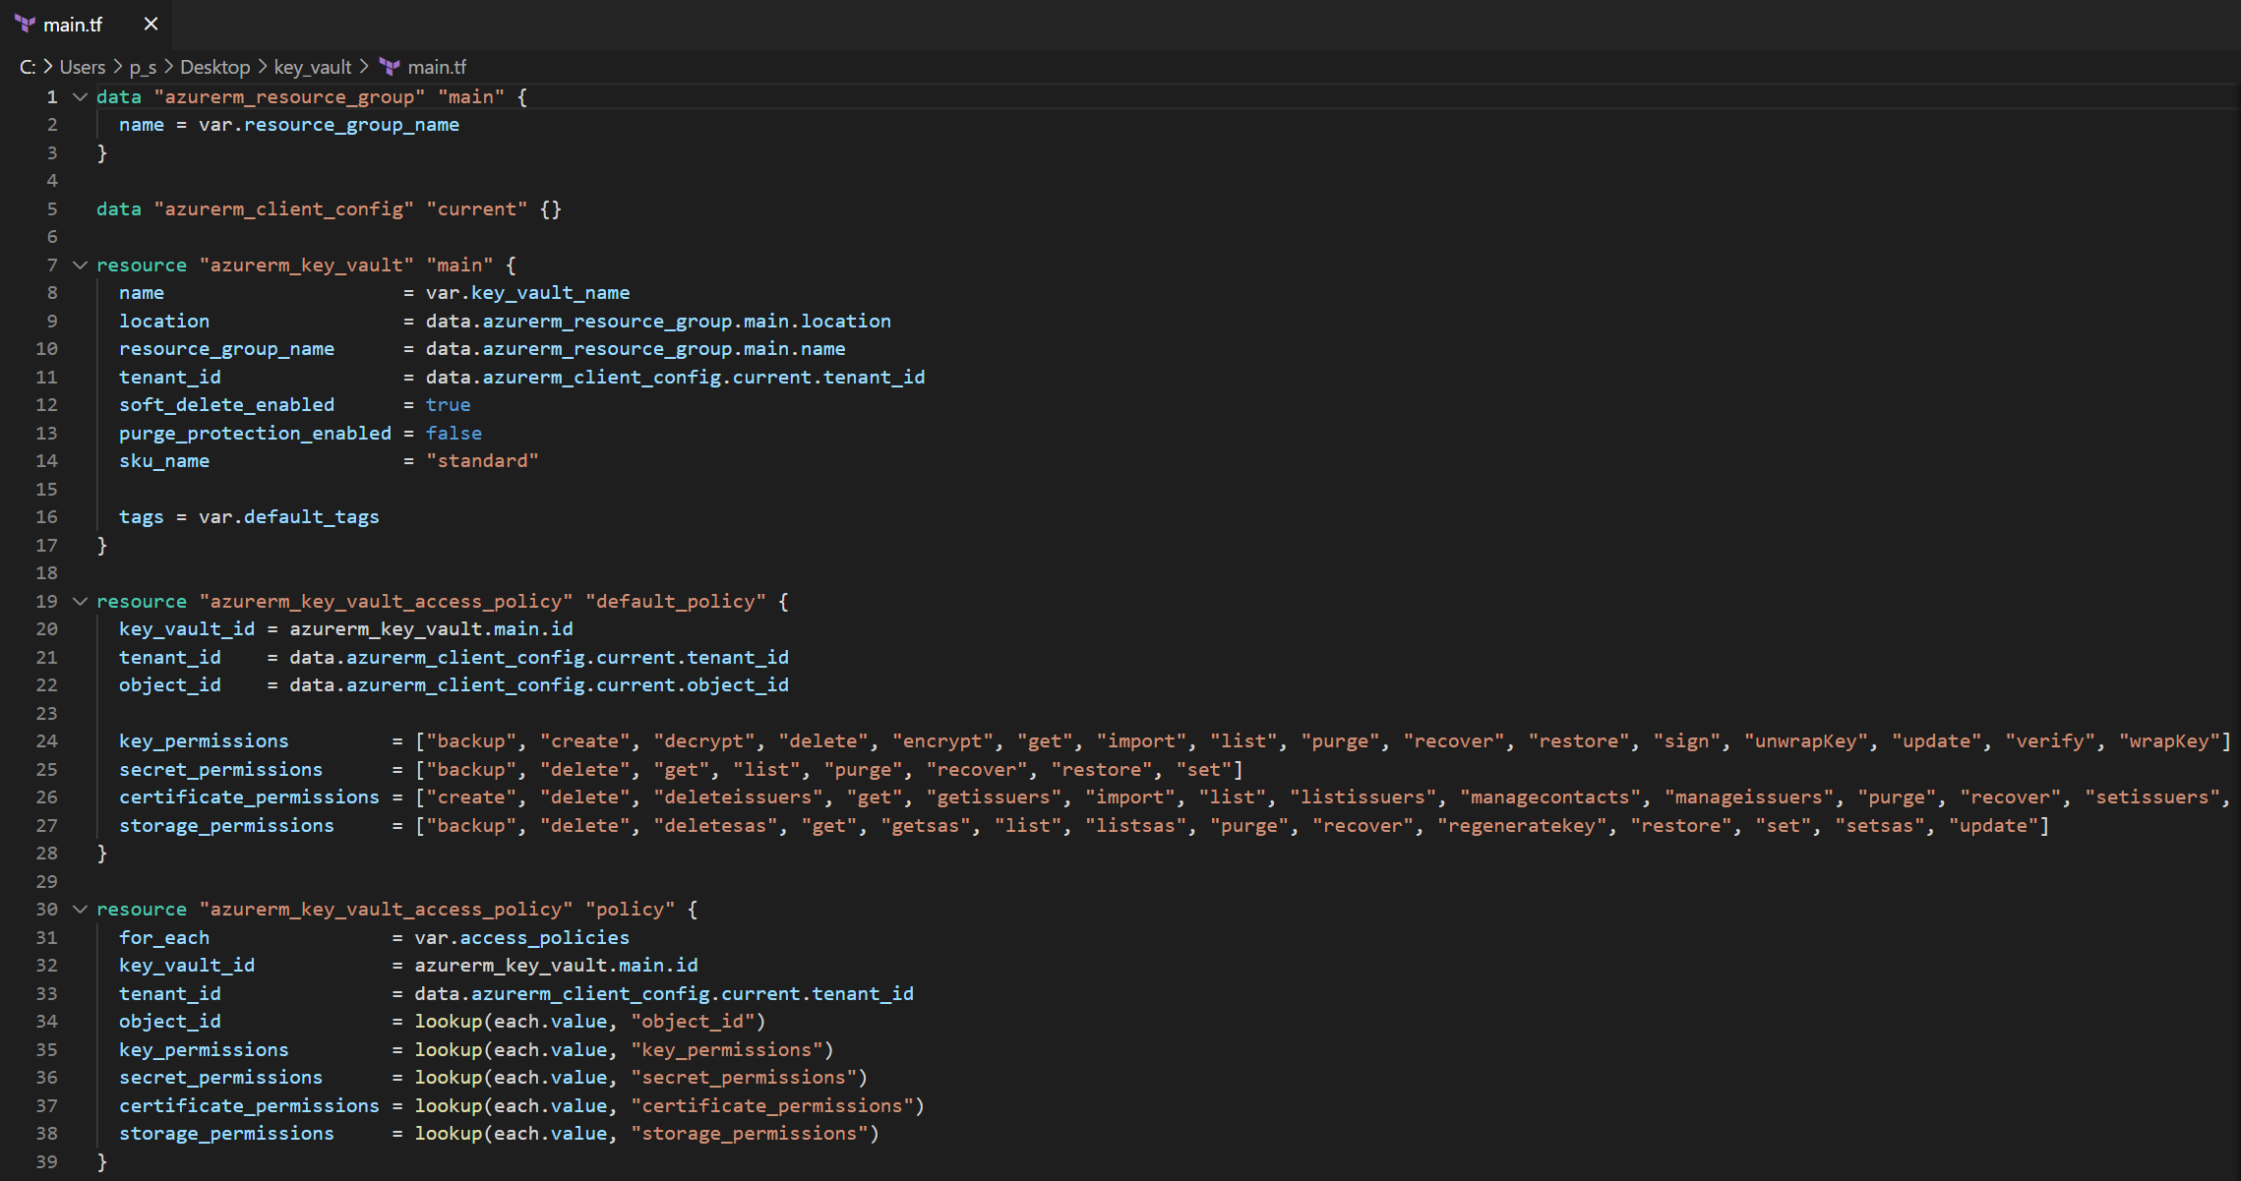
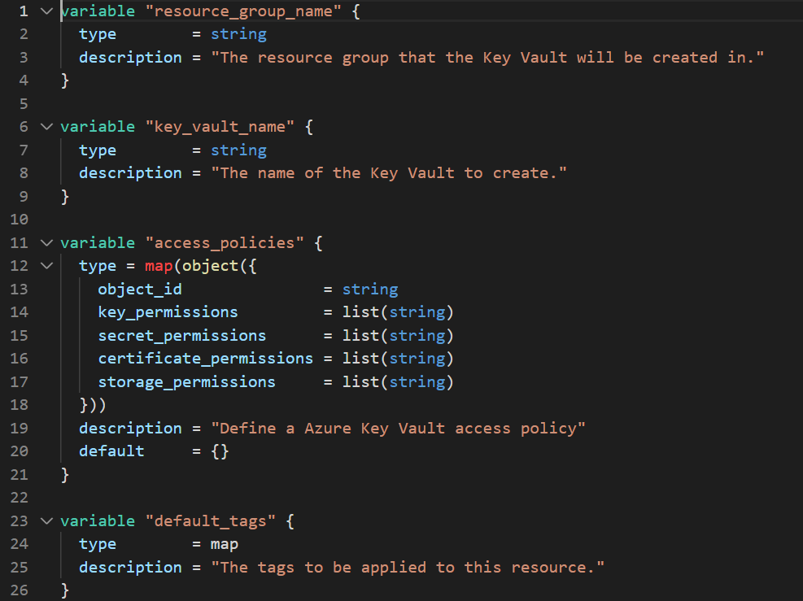
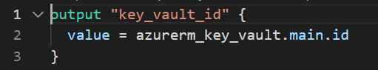
Intro to Infrastructure as a code – Introduction to Terraform
Defining Modules
1
2
3
Notes:
Main.tf – maintain code of the module
Outputs.tf – define what values will be output from the module
Variables.tf – define input variables to the module

Slide 31







Breaking down into Reusable Components
Application - Reusable individual components (Terraform)
Application Concept
Main.tf
Azure Key Vault.tf (module)
Azure Databricks.tf (module)
Azure SQL Database.tf (module)
Azure SQL Server.tf (module)
Azure Data Factory.tf (module)
Azure Data Lake.tf (module)
Notes:
Deployment steps:
e.g. for Release Infrastructure it can be
deploy ARM/Terraform templates to the environment with this parameters (injected via variable groups)
Run Script to configure security and configuration

Slide 32
Agenda
Intro to infrastructure as a code (IaaC)
ARM Introduction
Terraform Introduction
Injecting Parameters
Secure Infrastructure deployment
Questions

Slide 33
Intro to Infrastructure as a code – Injecting Parameters
Providing Parameters to IaaC Templates in CICD
Defining Parameters in the terraform template
Notes:
Infrastructure as a Code
Are there any other types of templates:
Yes – e.g. Terraform (They use different syntax), they would also require different deployment script

Slide 34
Intro to Infrastructure as a code – Injecting Parameters
Injecting Parameters to IaaC templates
No DevOps - (IaaC but no Pipelines)
Manually - during deployment)
In the File - e.g., defaults etc., Locals.tf)
DevOps – (IaaC and Pipelines)
DevOps Library Variable Groups
Key Vault Backed Variable Groups
Notes:
Infrastructure as a Code
Are there any other types of templates:
Yes – e.g. Terraform (They use different syntax), they would also require different deployment script

Slide 35

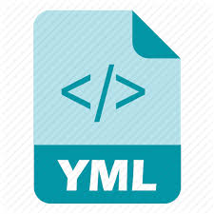
Intro to Infrastructure as a code – Injecting Parameters
Injecting Parameters to IaaC templates (DevOps)
Library Variable Group (DEV, TEST, PROD)
@
@
YAML Pipeline.yaml
@
Terroaform-Inrastructure.tf
@
Notes:
Infrastructure as a Code
Are there any other types of templates:
Yes – e.g. Terraform (They use different syntax), they would also require different deployment script

Slide 36
Agenda
Intro to infrastructure as a code (IaaC)
ARM Introduction
Terraform Introduction
Injecting Parameters
Secure Infrastructure deployment
Questions

Slide 37
Intro to Infrastructure as a code – Introduction to Terraform
Keeping Parameters/Variables Secure
Do not store sensitive parameters/variables in the file – especially if they get committed to repository
Define your parameters as sensitive if it contains sensitive information (passwords, keys, Connection Strings etc.)
Injecting Parameters from the Pipeline (via Variable Groups)
Encrypt sensitive values in DevOps Variable Groups
Use Azure KeyVault backed variables Group)
Notes:
Infrastructure as a Code
Are there any other types of templates:
Yes – e.g. Terraform (They use different syntax), they would also require different deployment script

Slide 38
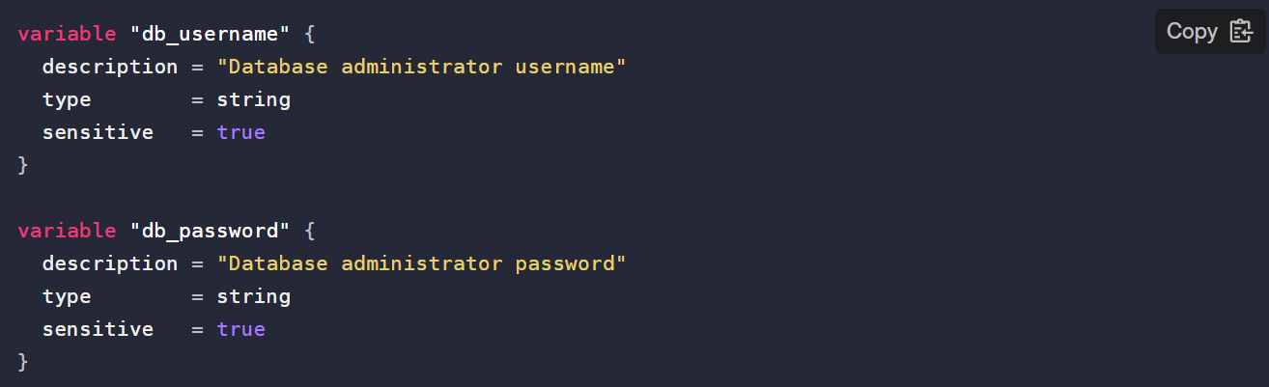
Intro to Infrastructure as a code – Introduction to Terraform
Protecting sensitive parameters
Notes:
Infrastructure as a Code
Are there any other types of templates:
Yes – e.g. Terraform (They use different syntax), they would also require different deployment script

Slide 39
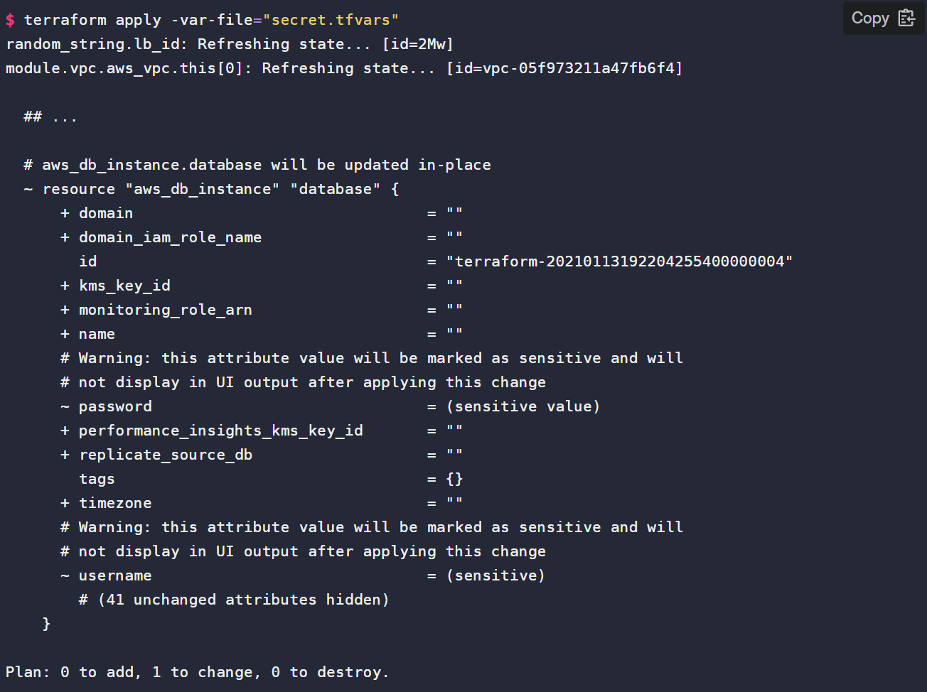
Module 2 – Introduction to Terraform - Parameters
Protecting sensitive parameters
Notes:
Infrastructure as a Code
Are there any other types of templates:
Yes – e.g. Terraform (They use different syntax), they would also require different deployment script

Slide 40
Agenda
Intro to infrastructure as a code (IaaC)
ARM Introduction
Terraform Introduction
Injecting Parameters
Secure Infrastructure deployment
Questions

Slide 41
Thank You

Slide 42

Install Terraform
Visualizing a DTP

Slide 43
Intro to Infrastructure as a code – Introduction to Terraform
Install Terraform –Tools –Terraform specific
-Terraform CLI (Local) -DevOps Pipelines Terraform add-on (DevOps)
Install Terraform – Tools – Provider specific (Azure)
Azure
-Azure CLI (Login to Azure)
-Azure Az/AzureRm PowerShell modules (calls to API)
Notes:
Infrastructure as a Code
Are there any other types of templates:
Yes – e.g. Terraform (They use different syntax), they would also require different deployment script

Slide 44
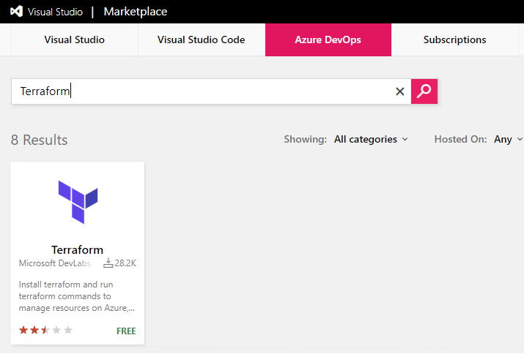
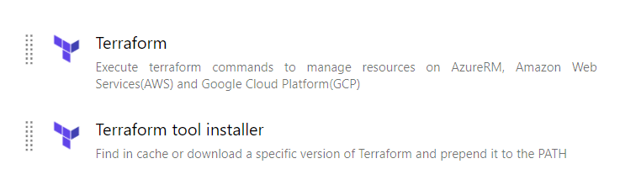
Intro to Infrastructure as a code – Introduction to Terraform
Install Terraform-DevOps?
Terraform task (marketplace) – allow run terraform commands as a part of the pipeline
Pipeline Tasks
Notes:
Infrastructure as a Code
Are there any other types of templates:
Yes – e.g. Terraform (They use different syntax), they would also require different deployment script

Slide 45
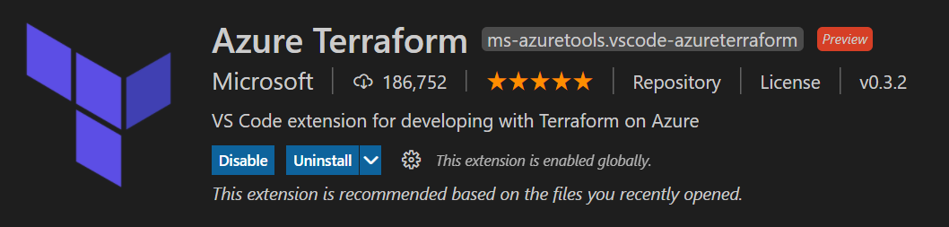
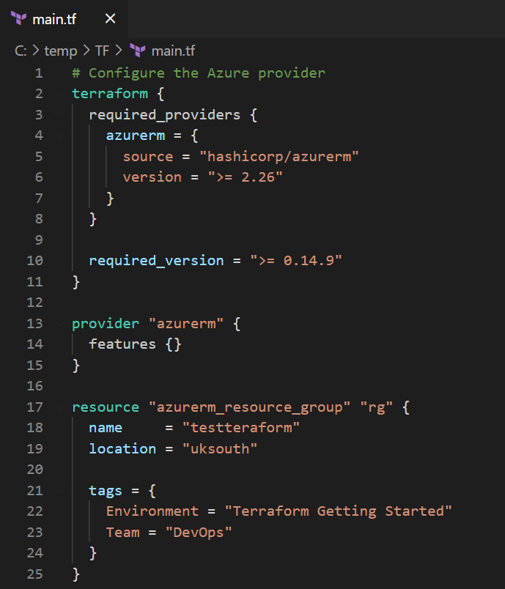
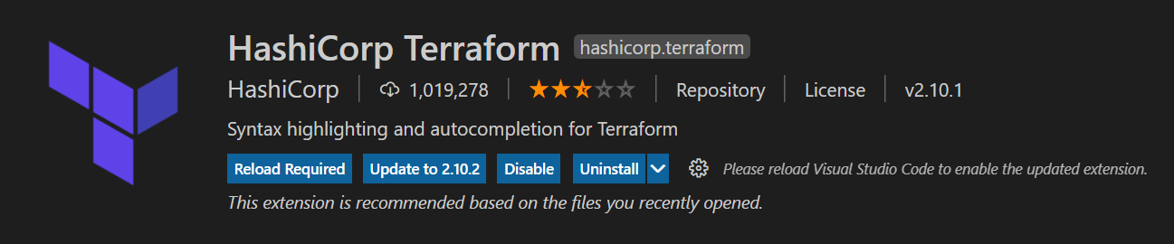
Intro to Infrastructure as a code – Introduction to Terraform
Install Terraform-Desktop?
Visual Studio Code Extension – intelisense like experience and colour coding (from Microsoft or HashiCorp)
or
Notes:
Infrastructure as a Code
Are there any other types of templates:
Yes – e.g. Terraform (They use different syntax), they would also require different deployment script

Slide 46
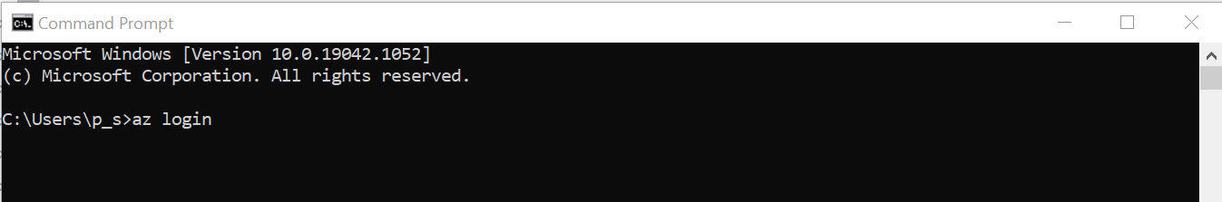
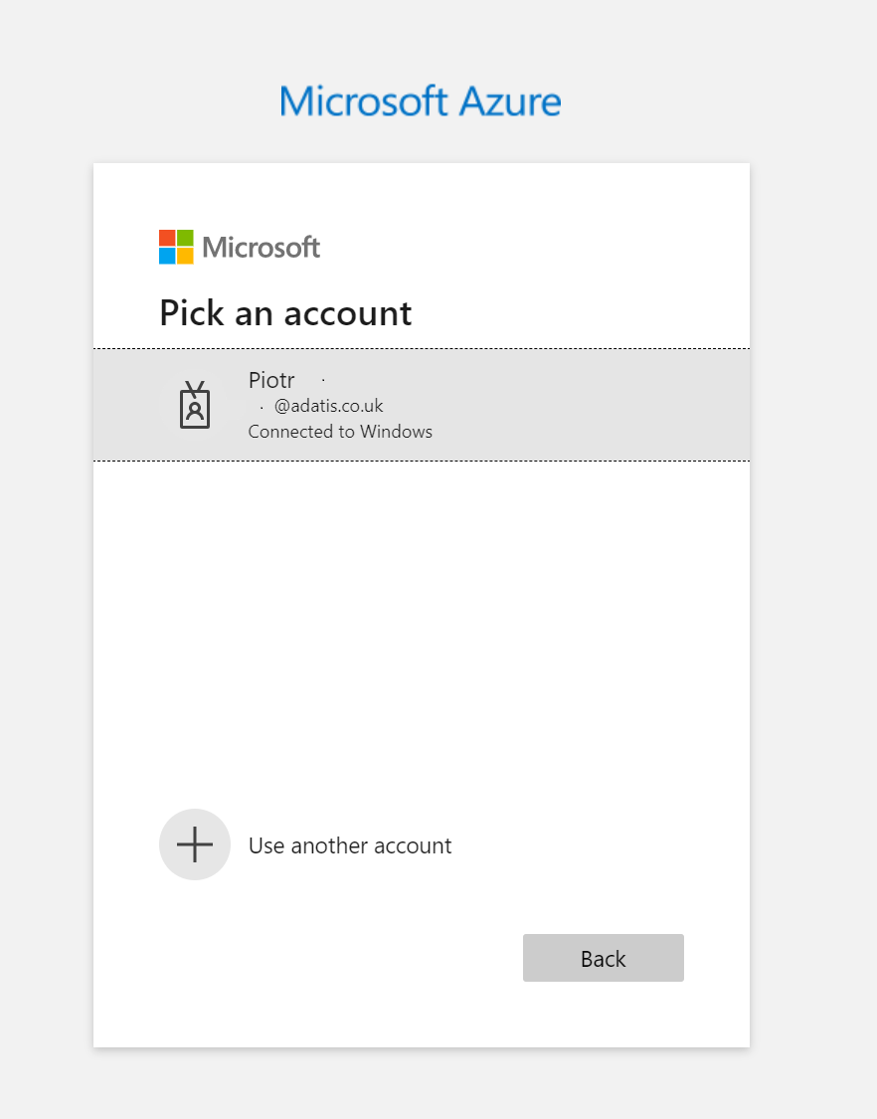
Module 2 – Introduction to Terraform - Parameters
Login to Azure
Open CMD
Run command: “az login”
Provide login to your account
Notes:
Infrastructure as a Code
Are there any other types of templates:
Yes – e.g. Terraform (They use different syntax), they would also require different deployment script

Slide 47
Introduction to ARM
Visualizing a DTP

Slide 48
Module 2 – Introduction to ARM – Understanding ARM Templates
What is Parameter File?
{
"$schema": "http://schema.management.azure.com/schemas/2015-01-01/deploymentParameters.json#",
"contentVersion": "1.0.0.0",
"parameters":{}
}
Notes:
# Sections:
$schema, contentVersion - same purpose like in template file, purpose of this is to define version of the validation template that is going to be used to validate ARM via ARM API
parameters – defines values for parameters that will be passed in to ARM template, these parameters need to be defined by arm template in arm template parameter section

Slide 49
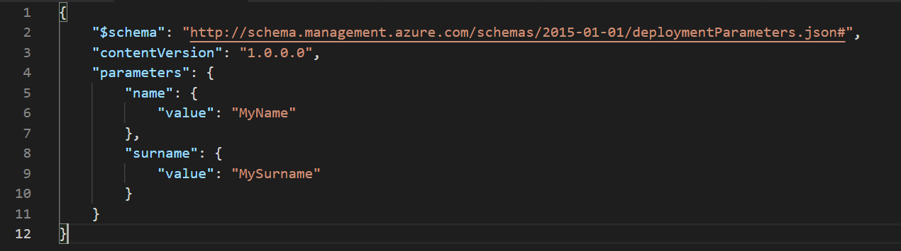
Module 2 – Introduction to ARM – Understanding ARM Templates
Examples of parameter file?
Real world example can be found: here
Notes:
#ARM Template is JSON
Schema, ConenteVersion, ApiProfile – must be defined for ARM API to understand what version of the schema your ARM Template requires
Parameters – defines parameters, their: types, default values, metadata description
Variables – defines variables that can be reused. E.g. when we want to combine two parameters
Functions – allow to define transformations that can be used to dynamically modify data
Resources – this section contain definition
Outoputs – Defines values that need to be outputted
#Characteristic of ARM
Is composed of different sections, when each section has its own responsibility (explained below)
Definition of each resource is strictly defined (templates can be found online or in VisualStudio ARM Project)
Can contain expression define by ARM language to dynamically control some of the content e.g. variables etc.
Can be automated by Power-Shell ( we can inject parameters)
Can contain multiple resources might be linked to each other (resources section is an array), it determines dependencies and deploy resources in right order

Slide 50
Module 2 – Introduction to ARM – Expression Language
Expressions
Used in variables, functions, can
All expressions are wrapped in square brackets “[ ]”
Syntax is specified in MS Documentation (allowed functions)
The value of the expression is evaluated when the template is deployed
An expression must on of the defined types: string, integer, boolean, array, or object
A template expression can't exceed 24,576 characters.
Examples of Expressions
"parameters": { "location": { "type": "string", "defaultValue": "[resourceGroup().location]" } },
Notes:
Dynamic content can be added to ARM template via Expression language
# list of all available expressions functions can be found here:
https://docs.microsoft.com/en-us/azure/azure-resource-manager/resource-group-template-functions
Language expressions are evaluated at deployment time (runtime)

Slide 51
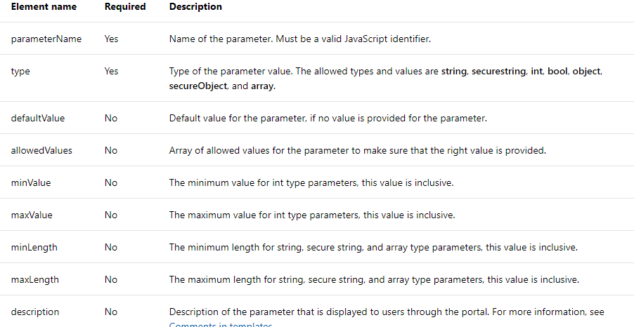
Module 2 – Introduction to ARM – Parameters options
Parameters options
Where to specify parameters option
This options need to be defined in ARM template file in parameter definition section on the top of the script
Notes:
# Parameters can be controlled by adding some configuration to their definition.
Despite long list, the most common are the one that are Required (first two)
#Best practice
It is best practice to not use default values for the parameters that we pass values for to enforce providing value by the script

Slide 52
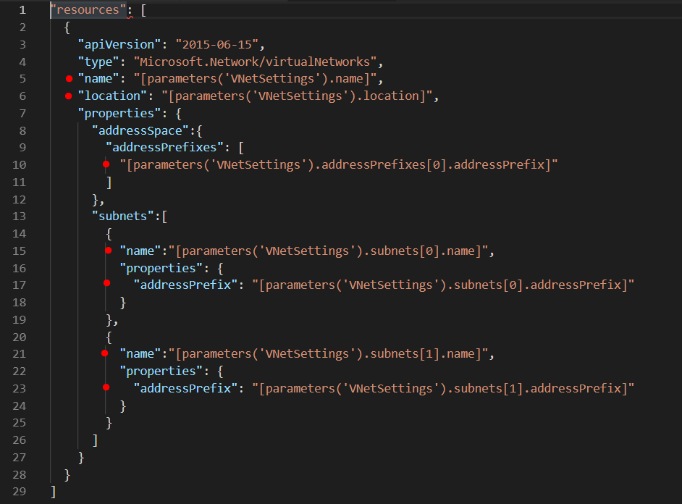
Module 2 – Introduction to ARM – How to use parameters
Syntax to use parameters
[parameters(‘paremeter_name’)]
Using Defined Parameter in the ARM Templates
Notes:
# Defined parameters can be used b

Slide 53
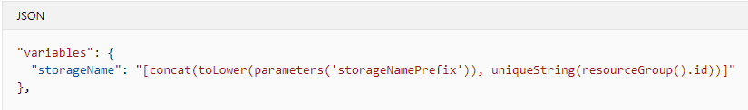
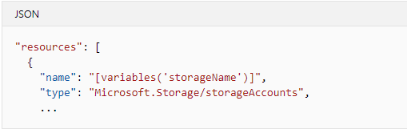
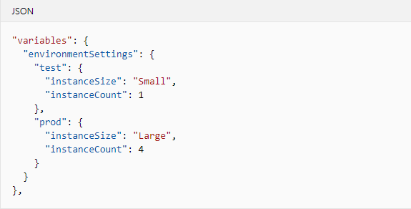
Module 2 – Introduction to ARM – Variables
Defining Variables
Usage of the Variable
Configuration Variables
Notes:
#definition of variables
Similar like for parameters, we define them on the top of the script and we can use them in the ARM template that they are defined.
#configuration variables
Variables allows to create not only key value pairs, but also complex objects
This way of the configuration is probably not required

Slide 54
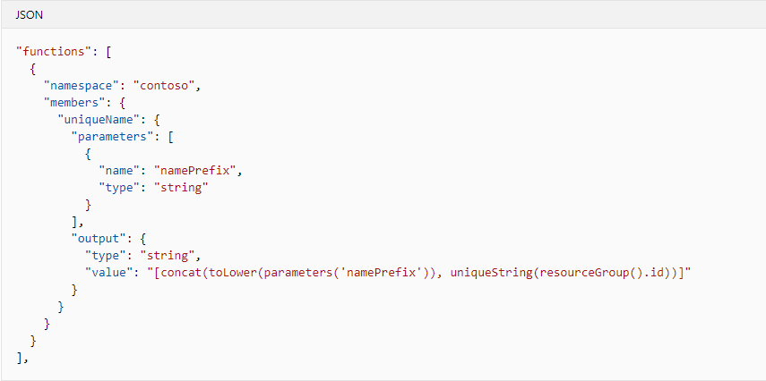
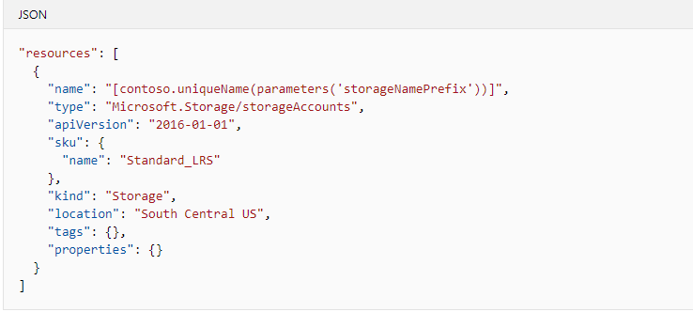
Module 2 – Introduction to ARM – Functions
Defining of ARM Functions
Using Functions in the template
Defines namespace scope
Function Parameters
Output type
[Namespace.Function(arguments)]
Notes:
#definition of functions
Similar like for parameters and variables, we define them on the top of the script and we can use them in the ARM template that they are defined
#Functions can
output complex objects if required
Be useful but there are not used very often
Can make you ARM easier to read when used wise ( only for recusing the code that repeats in multiple places)

Slide 55
Other Tools
Visualizing a DTP

Slide 56
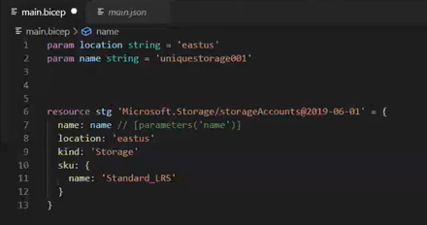
Module 2 – Introduction to Terraform - Parameters
Other Tools used for IAC - BICEP
Supports Azure Cloud provider only
Syntactic sugar on the top of ARM
Compiled to ARM
Use same runtime as ARM
Simplified syntax over ARM - can use same functions etc.
Does not require state maintenance outside for Azure
Will be able to use same Az modules
Require BICEP CLI
Not production ready yet
Notes:
Infrastructure as a Code
Are there any other types of templates:
Yes – e.g. Terraform (They use different syntax), they would also require different deployment script

Slide 57
Module 2 – Introduction to Terraform - Parameters
Other Tools used for IAC – PULUMI
Targeting Multiple providers
You can use languages to define the infrastructure
Python, Go, JavaScript, TypeScript, and C#
Maintain state externally – automatically app.pulumi.com Service
Notes:
Infrastructure as a Code
Are there any other types of templates:
Yes – e.g. Terraform (They use different syntax), they would also require different deployment script

